Slide 1
Data Visualization

Slide 2
Data Visualization
Data visualization deals with visual representation of data. It graphically plots data and is an effective way to communicate inferences from data.
Python offers several plotting libraries
Pandas
Matplotlib
Seaborn
Bokeh
Altair
plotly

Slide 3
Data Visualization Libraries
Matplotlib - Matplotlib is a visualization library in Python for 2D plots of arrays. It uses the NumPy library.
Seaborn - data visualization library built on top of Matplotlib, designed for statistical graphics and beautiful plots.
Bokeh - interactive visualization library for modern web browsers. It is suitable for large or streaming data assets and can be used to develop interactive plots and dashboards.
Altair - interactive and concise visualizations with pandas.
Plotly - interactive visualization library that supports zooming, panning, hover effects, and animations.

Slide 4
Using the correct visualization
To extract the required information from the different visuals it is essential to use the correct representation based on the type of data and the questions that are to be answered.

Slide 5
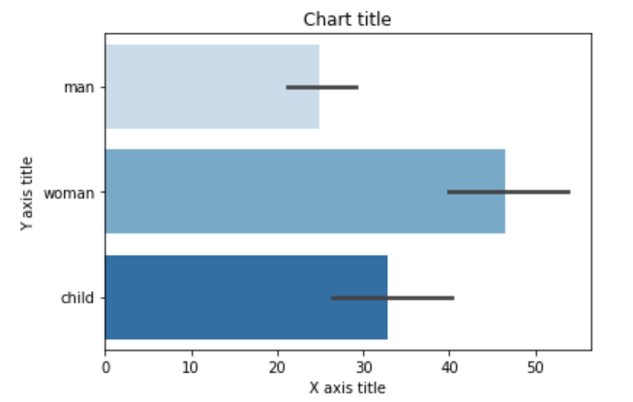
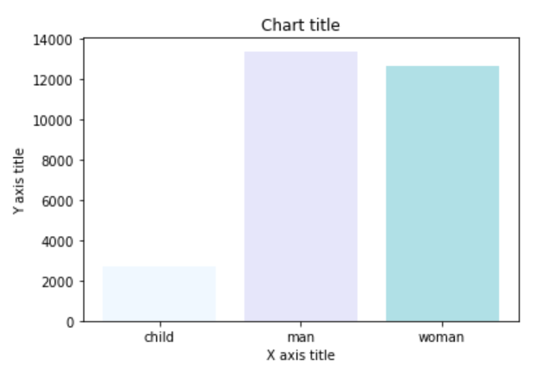
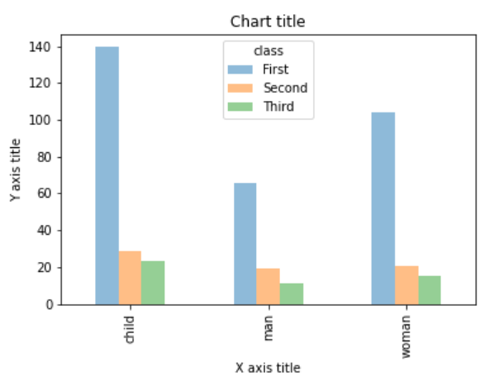
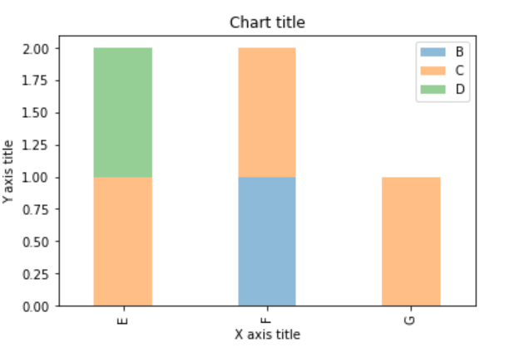
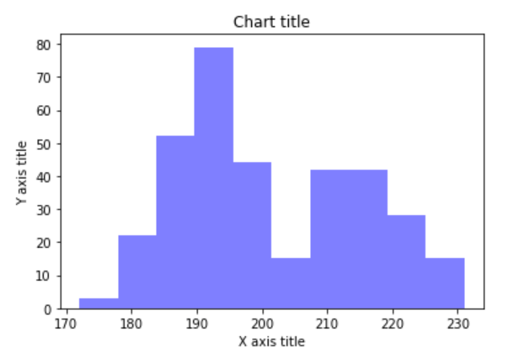
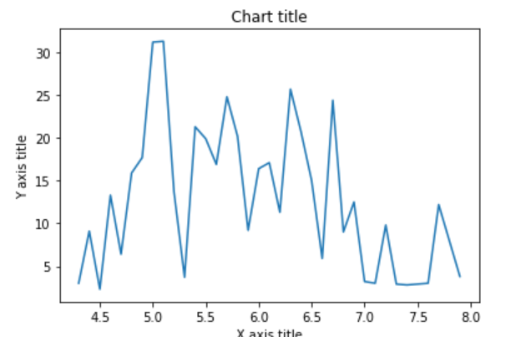
Types of visuals
Bar chart
Column chart
Grouped bar chart
Stacked bar chart
Histogram
Line chart

Slide 6
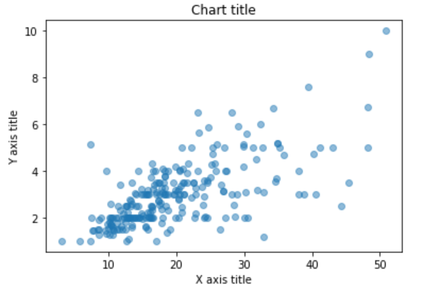
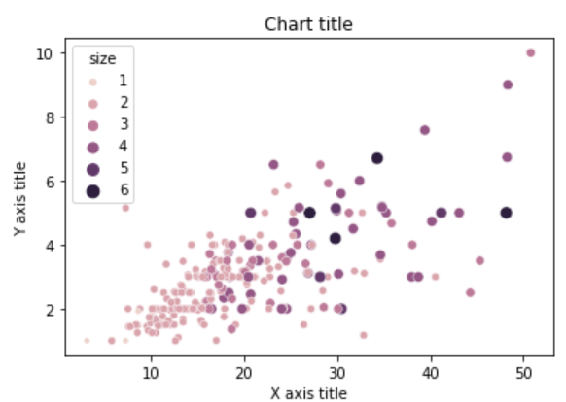
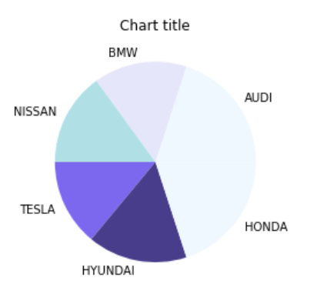
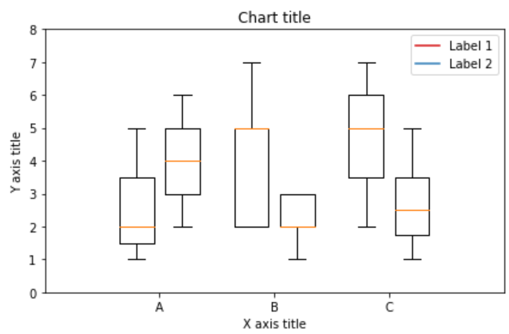
Types of visuals
Scatter plot
Bubble chart
Pie chart
Box plot

Slide 7
plot() in Matplotlib
The plot() function in Matplotlib is used to create line plots (and more) for visualizing data.
To use
import matplotlib.pyplot as plt
Syntax
plt.plot(x, y, format) # format is optional
x: Data for the x-axis
y: Data for the y-axis
format: Optional style (color, marker, line type)

Slide 8
plot() in Pandas
Used to directly visualize Series and DataFrame objects.
Automatically integrates with Matplotlib.
To use
import matplotlib.pyplot as plt
Syntax
df.plot(kind='line', x='column1', y='column2', title="Graph Title")
plt.show()
kind= → Specifies the plot type (e.g., 'line', 'bar', 'scatter', etc.).
x= → Sets the x-axis (for DataFrame plots).
y= → Sets the y-axis (for DataFrame plots).
title= → Adds a title.

Slide 9
Matplotlib: figures and subplots
plt.figure()
creates a blank figure, useful when making multiple plots
plt.figure(figsize=(6, 4), dpi=100, facecolor='lightgray’)
figsize=(width, height): Sets figure size in inches
dpi=100: Sets resolution (Dots Per Inch)
facecolor='lightgray': Sets background color

Slide 10
Matplotlib: figures and subplots
The add_subplot() method in Matplotlib is used to create and add subplots to a figure. It allows multiple plots to be arranged in a grid-like structure.
Syntax
fig = plt.figure()
ax = fig.add_subplot(nrows, ncols, index)
where,
nrows: Number of rows in the subplot grid
ncols: Number of columns in the subplot grid
index: Position of the subplot (starts from 1, left to right, top to bottom)

Slide 11
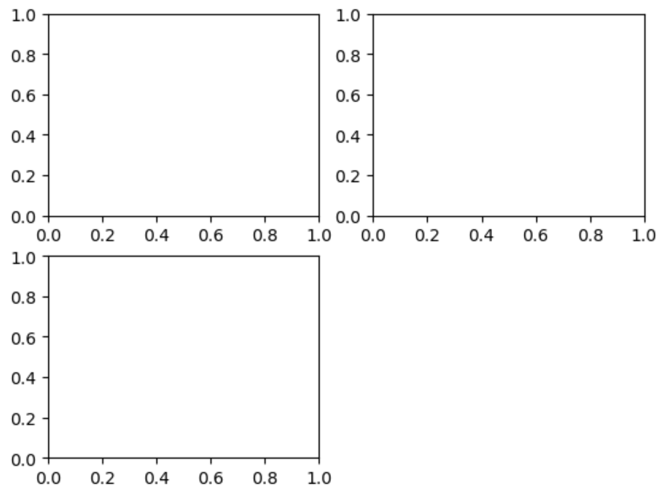
Matplotlib: figures and subplots example
fig = plt.figure()
ax1 = fig.add_subplot(2, 2, 1)
ax2 = fig.add_subplot(2, 2, 2)
ax3 = fig.add_subplot(2, 2, 3)

Slide 12
Matplotlib: subplots_adjust()
The subplots_adjust() function in Matplotlib is used to fine-tune the spacing between subplots in a figure. It helps avoid overlapping plots and improves the layout.
Syntax:
plt.subplots_adjust(left, bottom, right, top, wspace, hspace)
where,
left, right: Adjusts horizontal margins
bottom, top: Adjusts vertical margins
wspace: Adjusts the width spacing between subplots
hspace: Adjusts the height spacing between subplots

Slide 13
Colors, Markers, and Line Styles
Colors
ax.plot(x, y, linestyle="--", color="green")
Color can be specified by using its hexcode {E.g. "#CECECE“}
Markers
plot function creates a continuous line plot, interpolating between points, it can occasionally be unclear where the points lie.
markers to highlight the actual data points

Slide 14
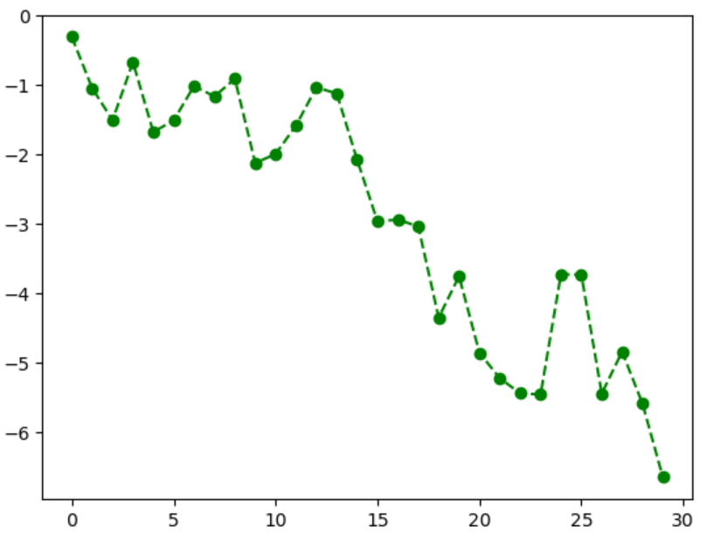
Colors, Markers, and Line Styles
fig = plt.figure()
ax = fig.add_subplot()
ax.plot(np.random.standard_normal(30).cumsum(), color="green", linestyle="dashed", marker="o")
plt.show()

